Slide 1

PRG 2(7)82 Project
By Mphela Napo(578379) ,Dylan Cheballah(577424), Hatlane Lowane(577413) , Tumelo Mabena(577583)

Slide 2
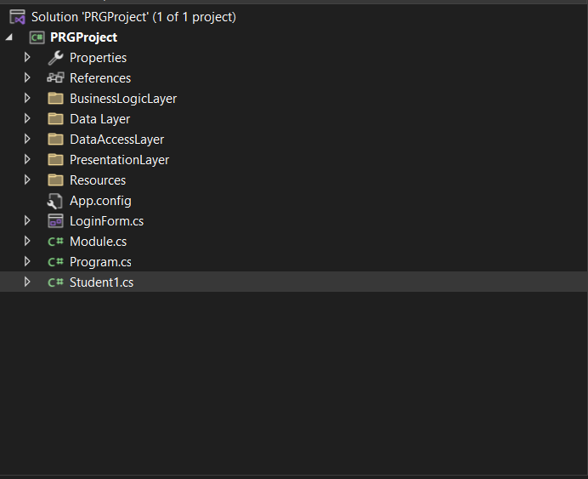
Structure of Layered Architecture

Slide 3
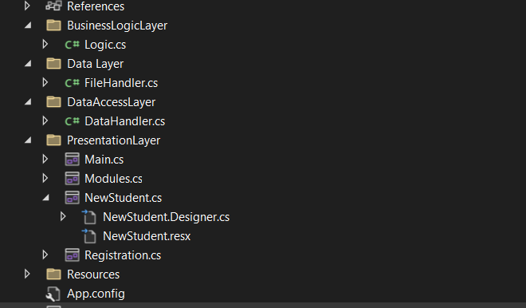
Layered Architecture Continued

Slide 4
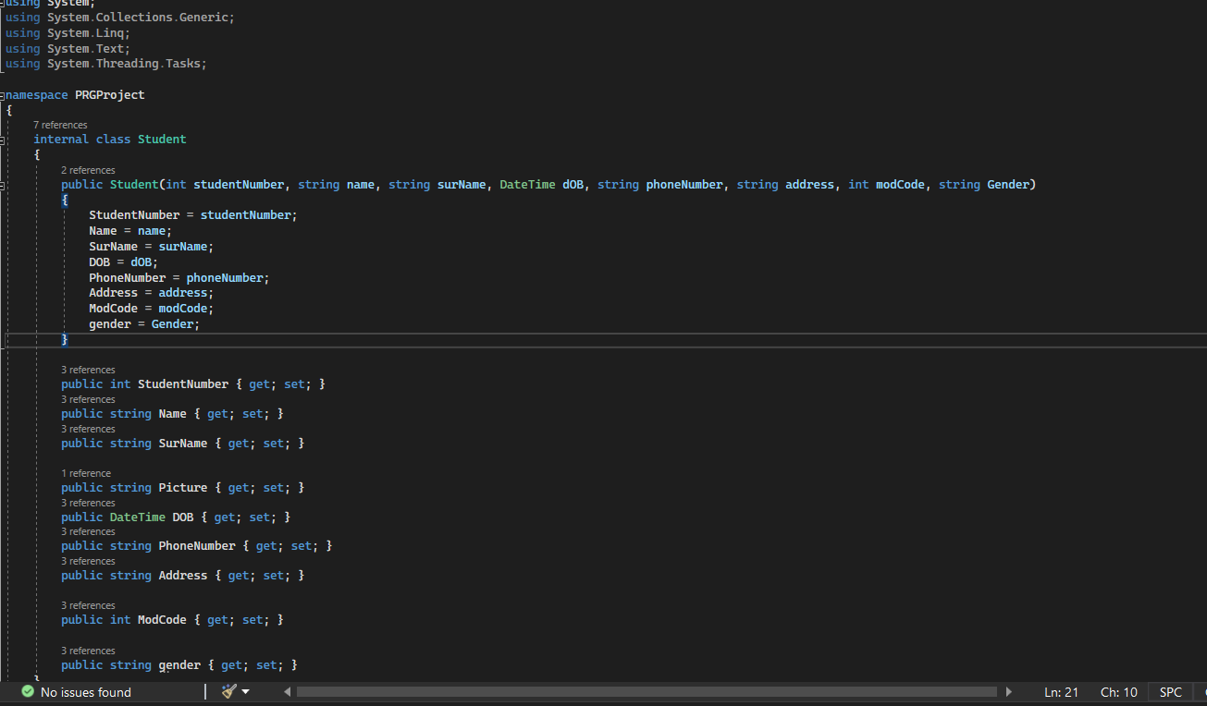
Student Class

Slide 5
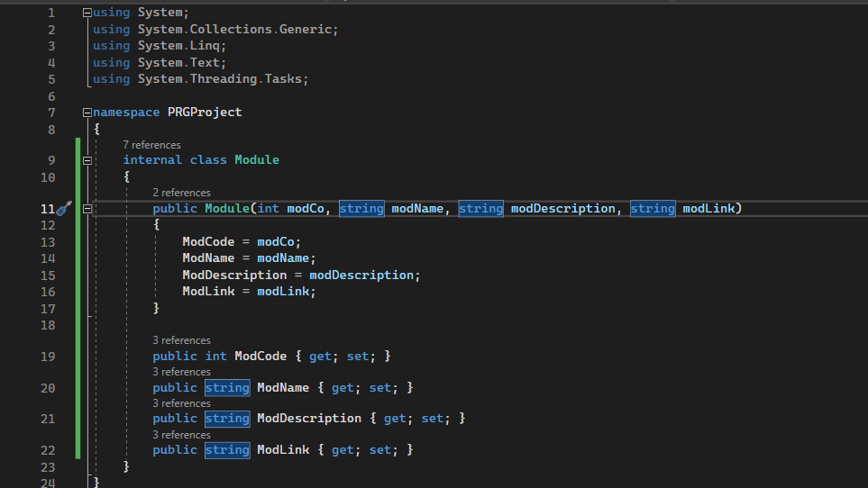
Module Class

Slide 6
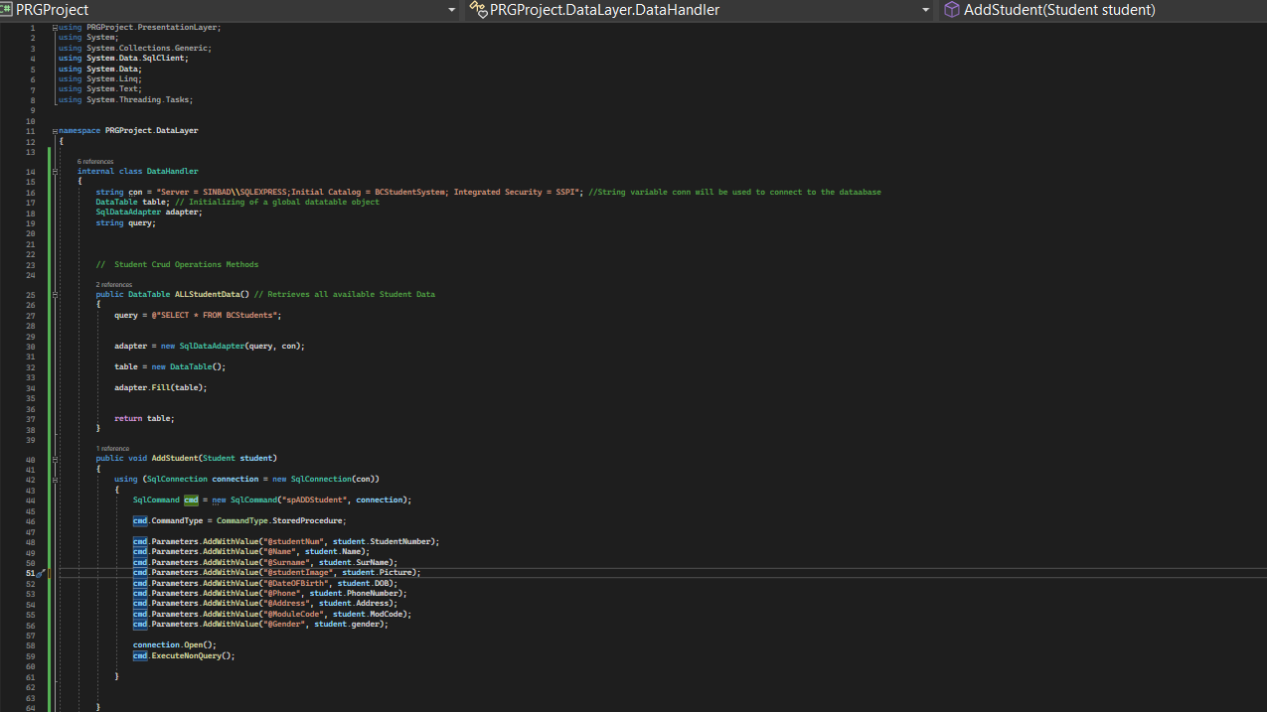
Student CRUD – DATA Access Layer

Slide 7
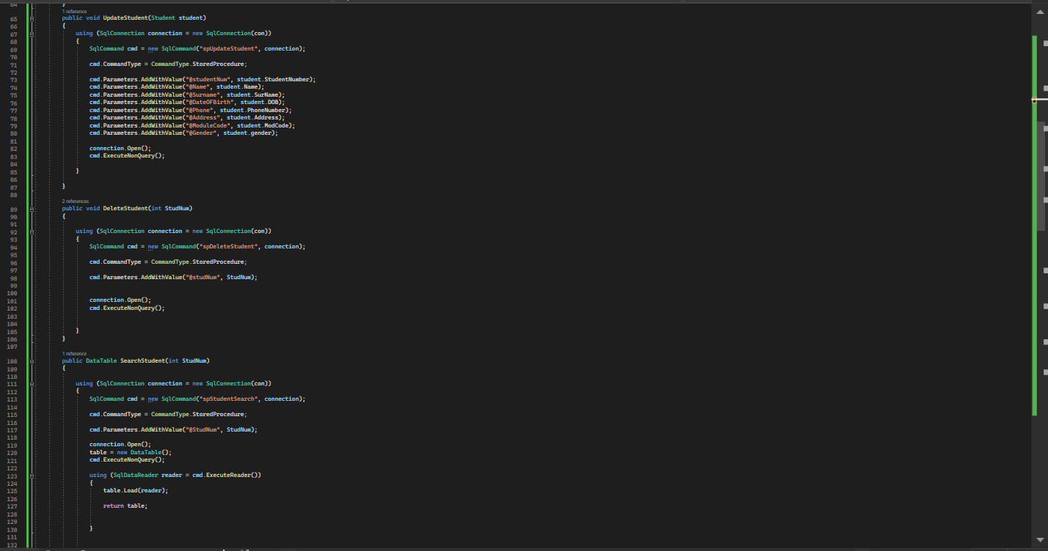
Student CRUD 2 – Data Access

Slide 8
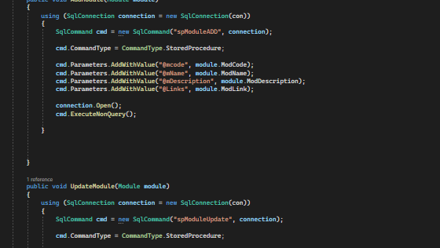
Module CRUD - 1

Slide 9
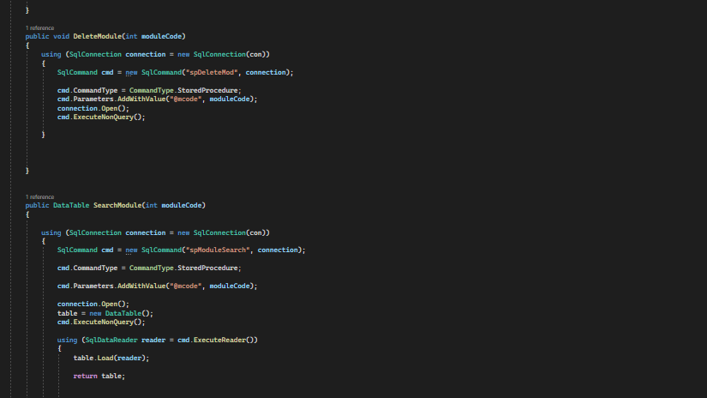
Module Crud 2 - Continued

Slide 10
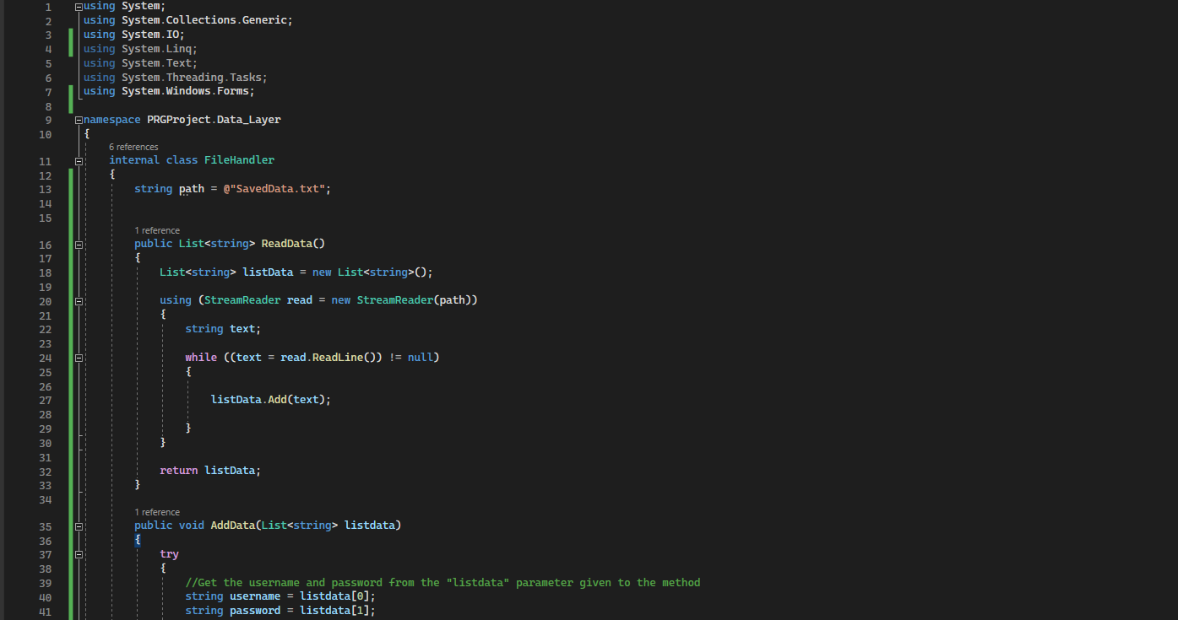
Data Layer - FileHandler

Slide 11
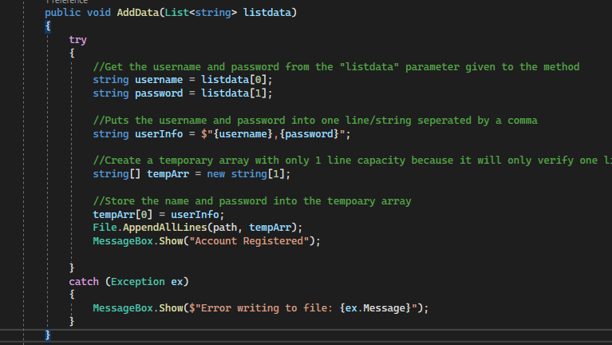
Data Layer – File Handler Continued

Slide 12
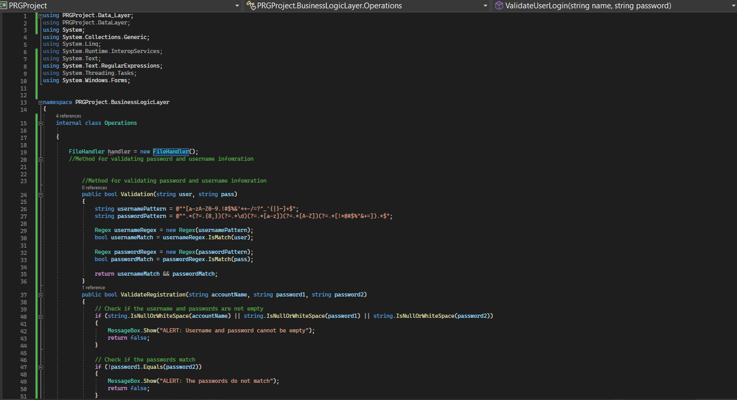
Business Logic Layer

Slide 13
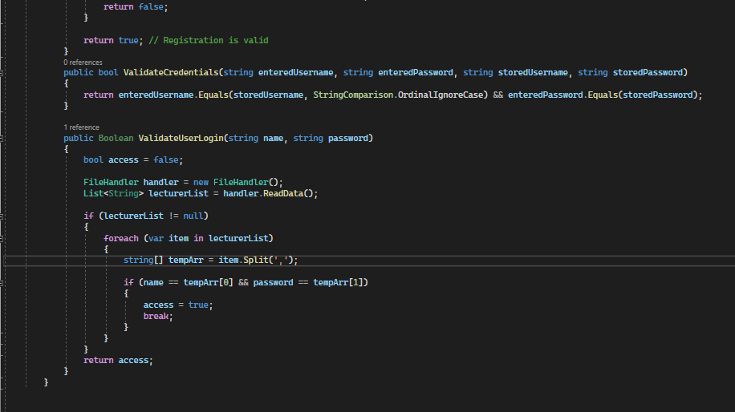
Business Logic Layer Continued

